Slide 1

High Level Architecture
Fire Panel with CCP
Integration Server
AlarmNet Server
Fire Panel
CCP
Distribution/Redirecting
Services
RAS Client
…
RAS Server
Fire Panel with CCP
Fire Panel
CCP
Consumer Module
ETW Applications &
Tools
No support for https (certificate)
Events with Unique Account-Code
Windows Event Tracing & Logging mechanisms
User account based which expects User-ID & Password
Web API
eVance QA Server

Slide 2


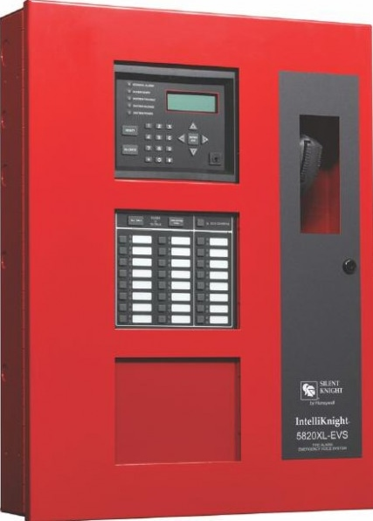




Unique Account-Code for CCP
CCP sends Events with Account-Code to AlarmNet Server
AlarmNet Server
5
6
Redirects events to Integration Server
4
Pushes Account-Code to Panel
Integration Server
1
Download configuration to panel using SK Tools
7
Sends events to eVance Server via Web-API that gets stored to respective event stores
Use of SK Tools comes into picture for these operations
SK Fire Panel with CCP
CCP
Events Store for Panel 1
Silent Knight Tools
……
…
Panel 1
Site 1
…
SK Fire Panel with CCP
Customer 1
…
CCP
Site X
Panel M
Events Store for Panel M
ESD
Customer N
2
Upload configuration file to eVance services for generation of Account Code
3
Retrieve Unique 6-Byte ACCOUNT-CODE from eVance Server

Slide 3
Unique Account-Code for CCP step-by-step
Step 1
ESD downloads configuration to the fire panel using SK Tools
ESD
Silent Knight Tools
Silent Knight Panel
Panel configuration
Step 2
For the customers who are registered for eVance licenses, the ESD sends the panel configuration files to eVance services for generation of unique Account-Code for each panel.
ESD
Panel configuration file
Unique 6-Byte Account-Code
Step 3
The 6-Byte Account-Codes are pushed to the panels directly or through use of SK Tools
ESD
Silent Knight Panel
Unique 6-Byte Account-Code

Slide 4
contd…
Step 4
CCP sends panel events with ACCOUNT-CODE to AlarmNet Server
SK Fire Panel with CCP
Panel events with Account-Code
AlarmNet
Server
CCP
Step 5
AlarmNet server redirects the events to an Integration Server
AlarmNet
Server
Events of all panels (along with Account-Codes)
Integration Server
Step 5
The Integration Server pushes the events to eVance Server through web API and the events are further stored into their respective panel event stores.
Events Store for Panel 1
Integration Server
Events of all panels
(along with Account-Codes)
…
Web API
Events Store for Panel M

